Slide 1
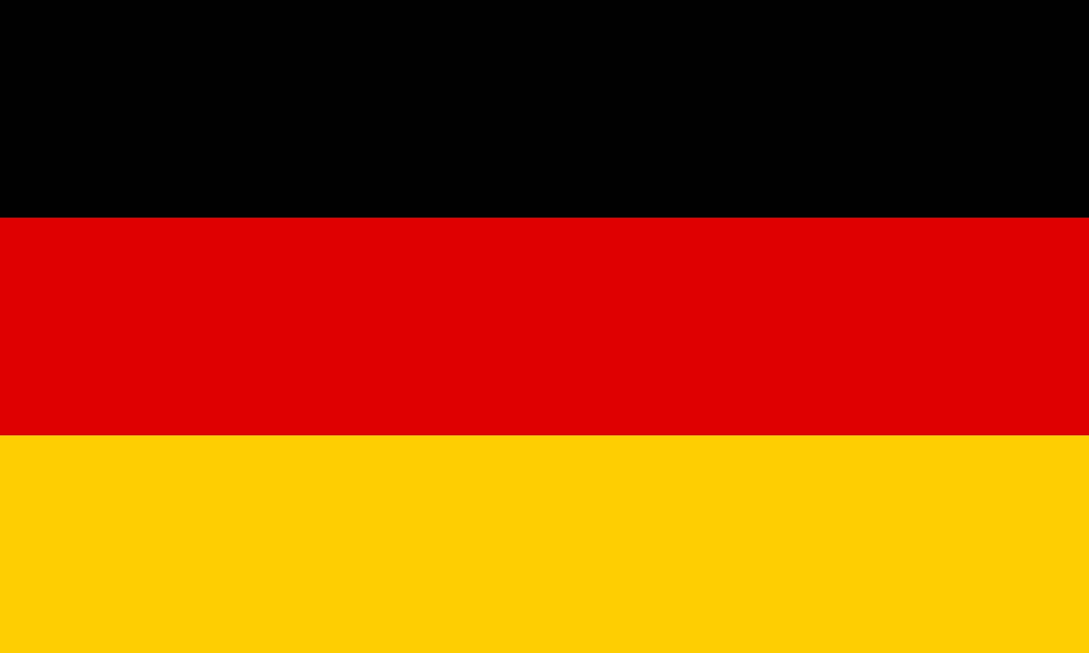


Slide 2
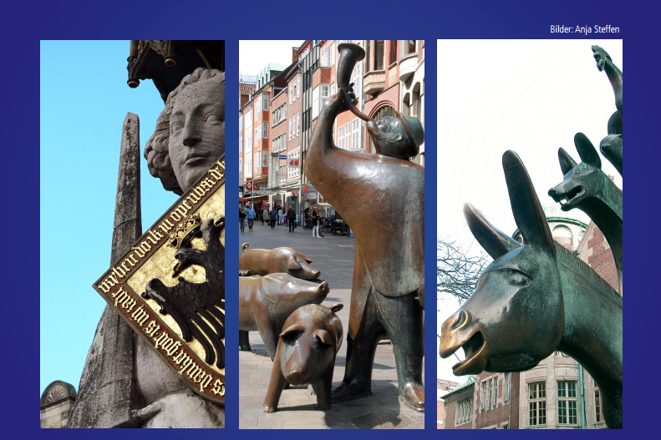
Bremen, Nord Deutschland

Slide 3
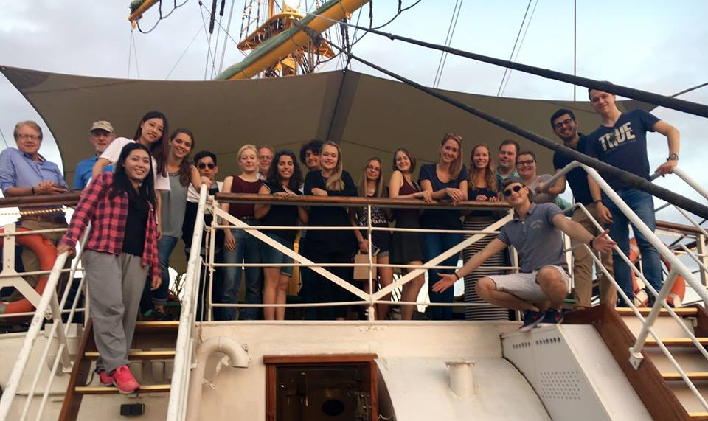
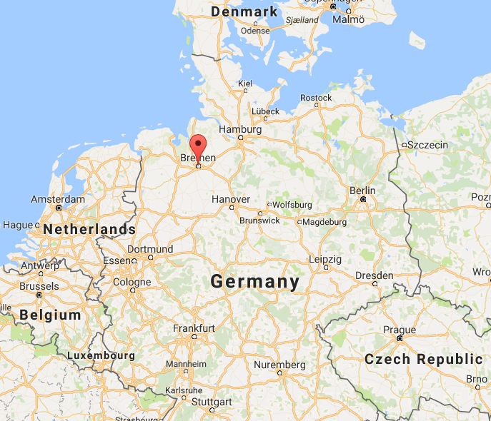
About Bremen and Rotary in Germany
The Camp participants and the ROTARACT CLUB OF BREMEN.
Bremen is a city straddling the Weser River in northwest Germany.
It’s known for its role in maritime trade- Known in German as a “Hansestadt”.

Slide 4
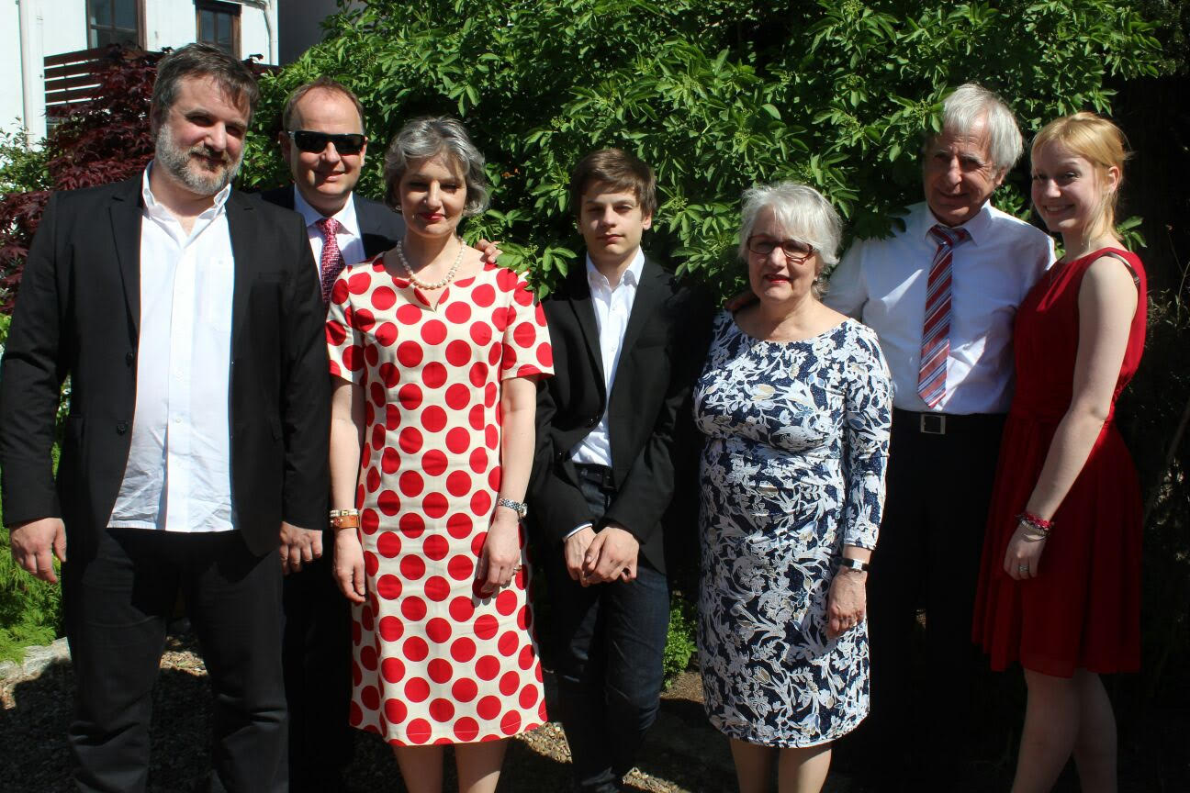
My host family for the first weekend- “The Sarstedet’s”

Slide 5
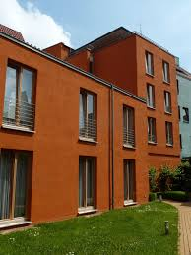
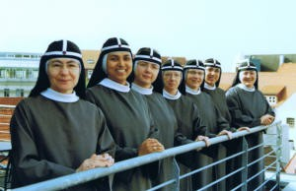
“Die Brigitten Kloster”
The Nunnery where we stayed for the rest of the camp

Slide 6
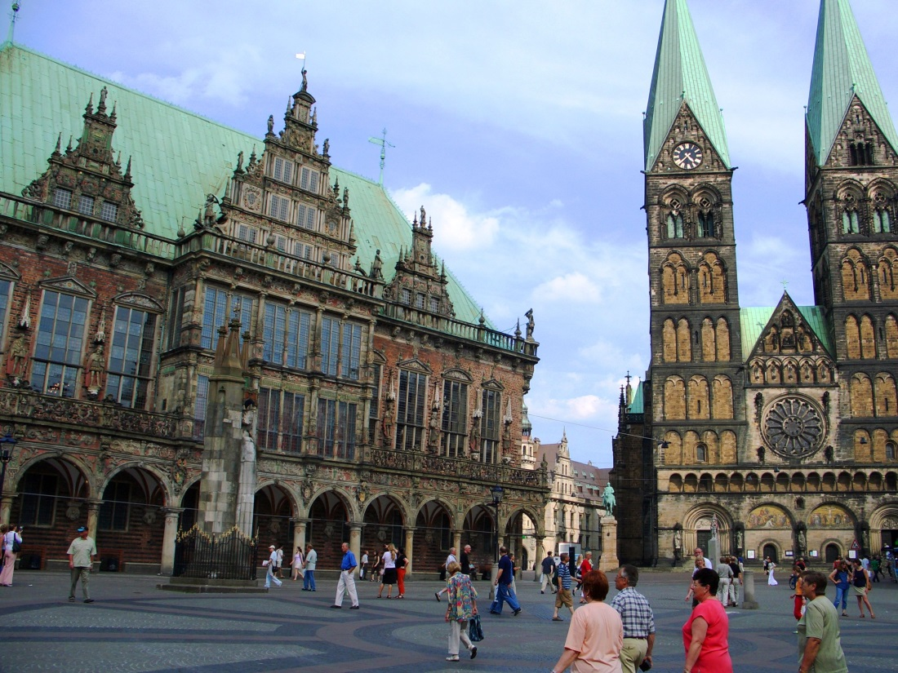
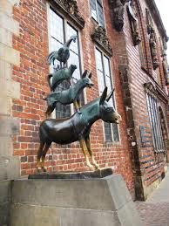
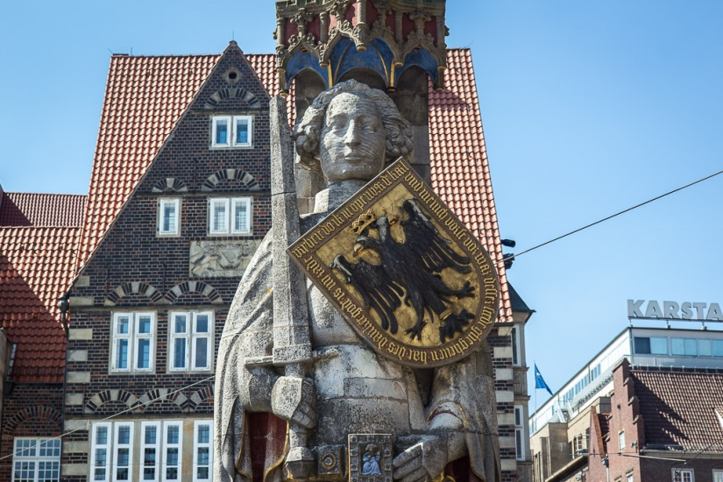
Camp highlights
Tour of the city

Slide 7
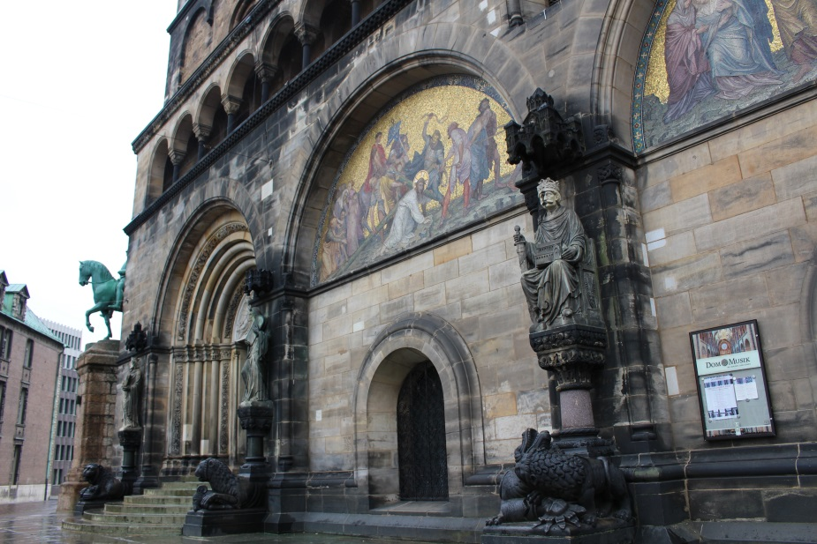
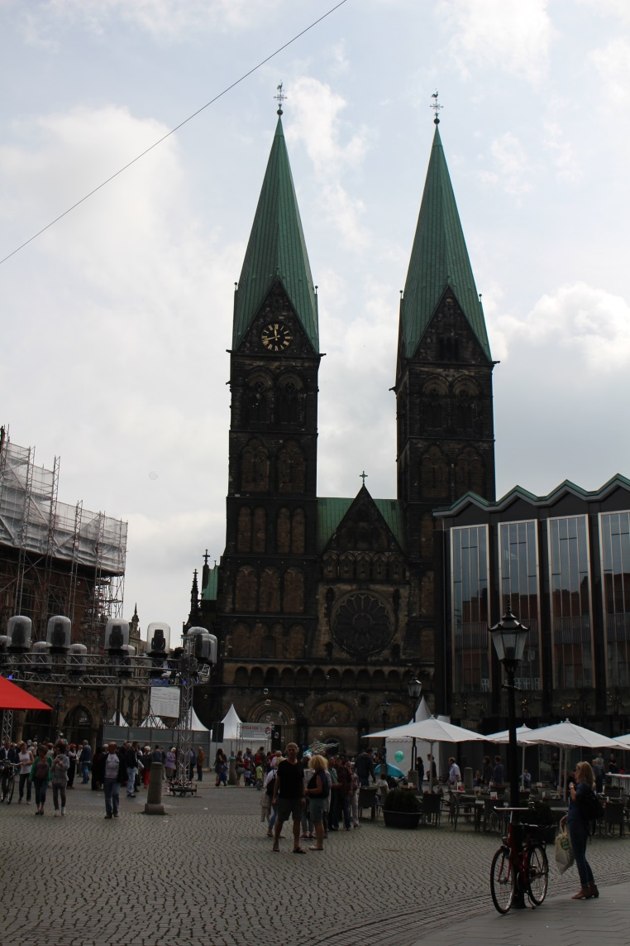
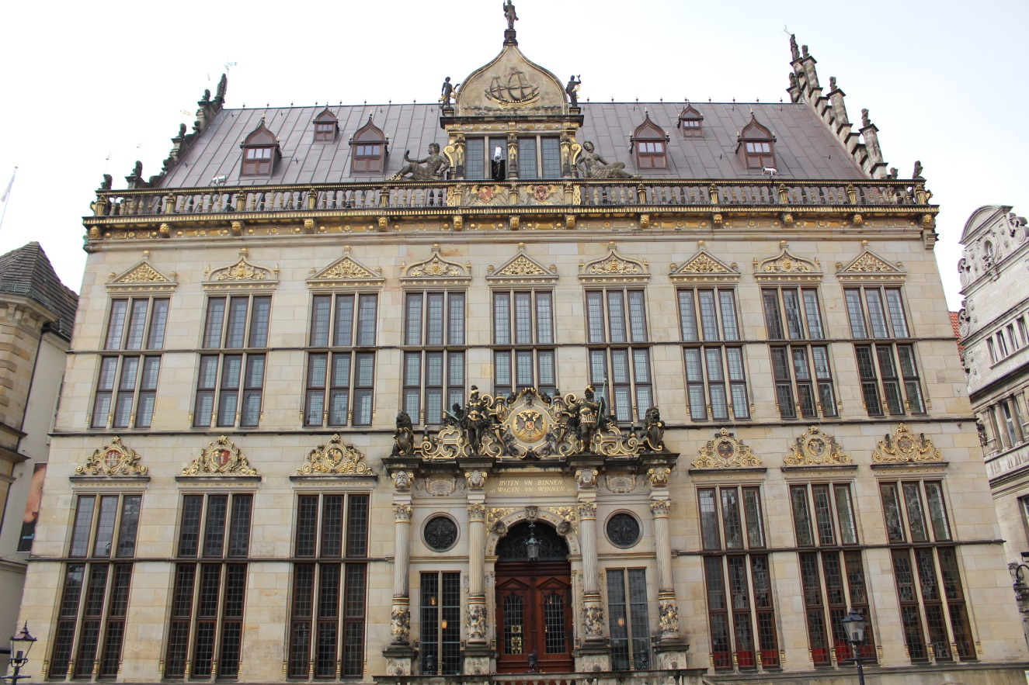
The “Rathaus” and Bremen Kirche

Slide 8
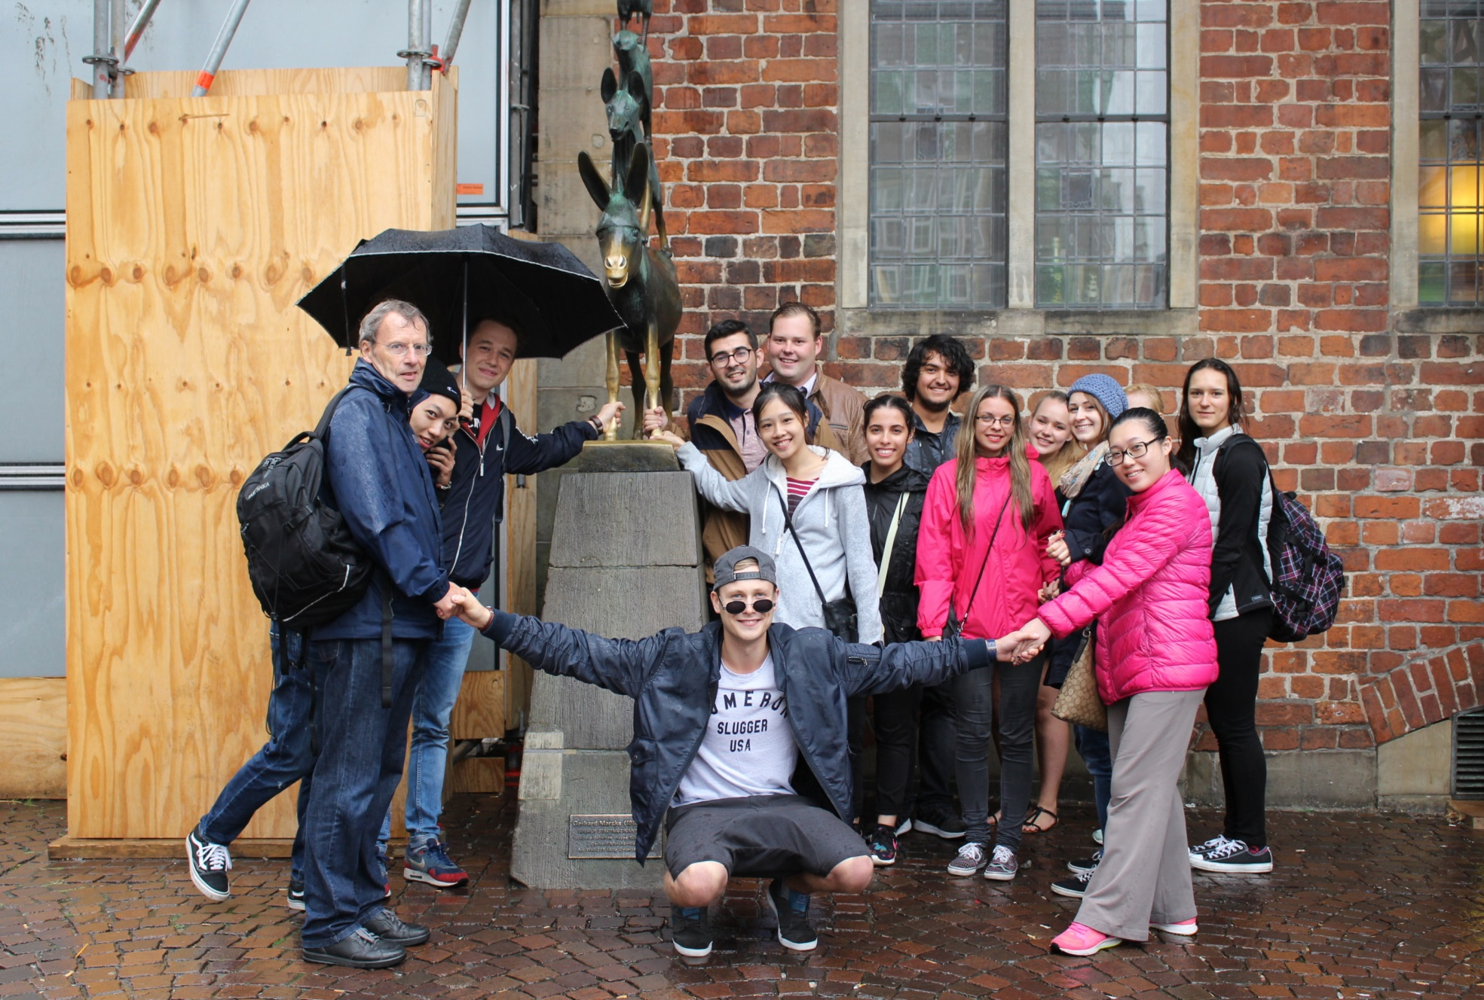
The Group
(Touching the legs of the Donkey is good luck)

Slide 9
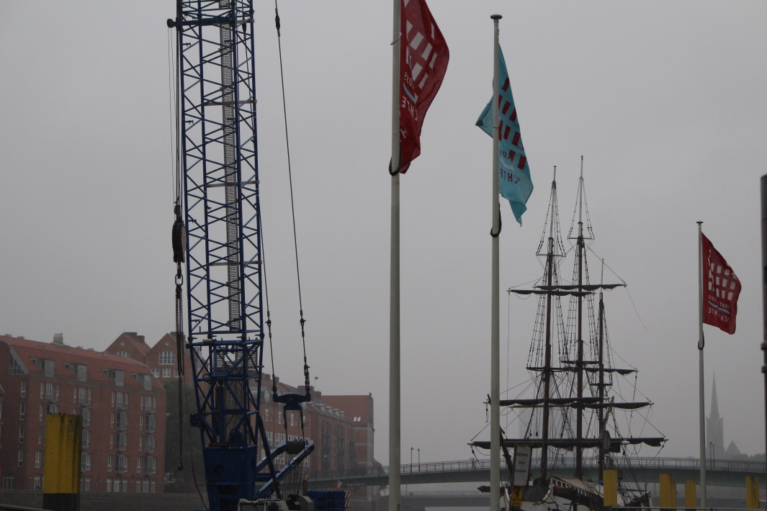
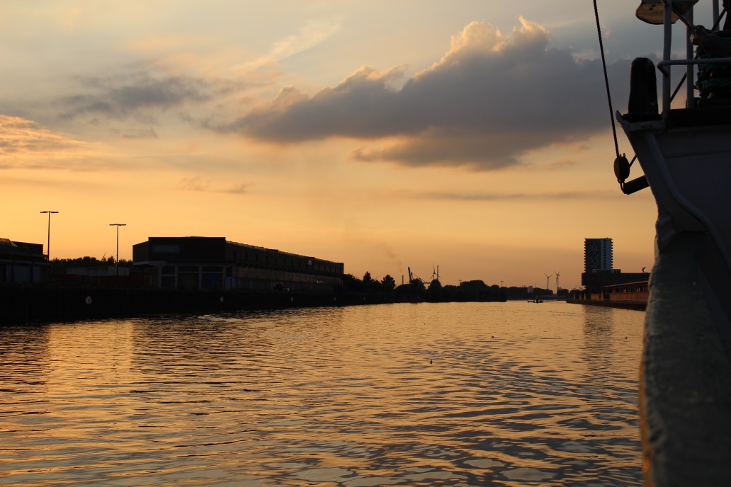
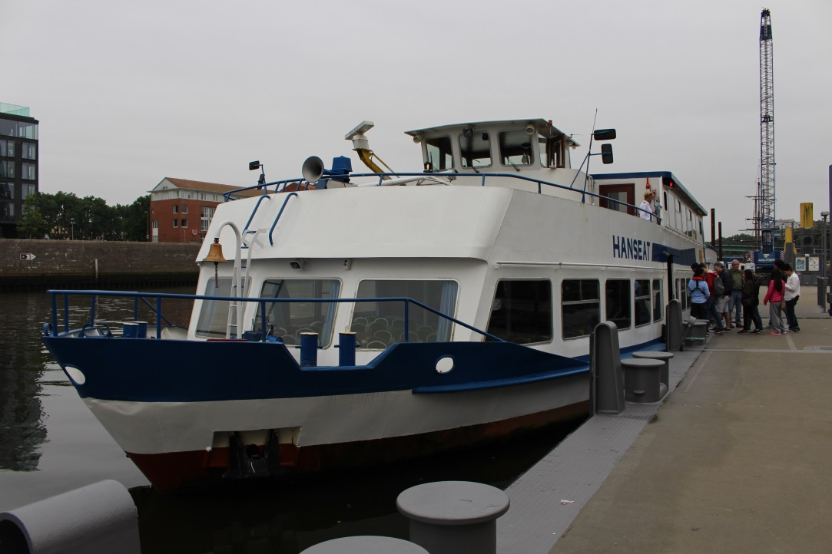
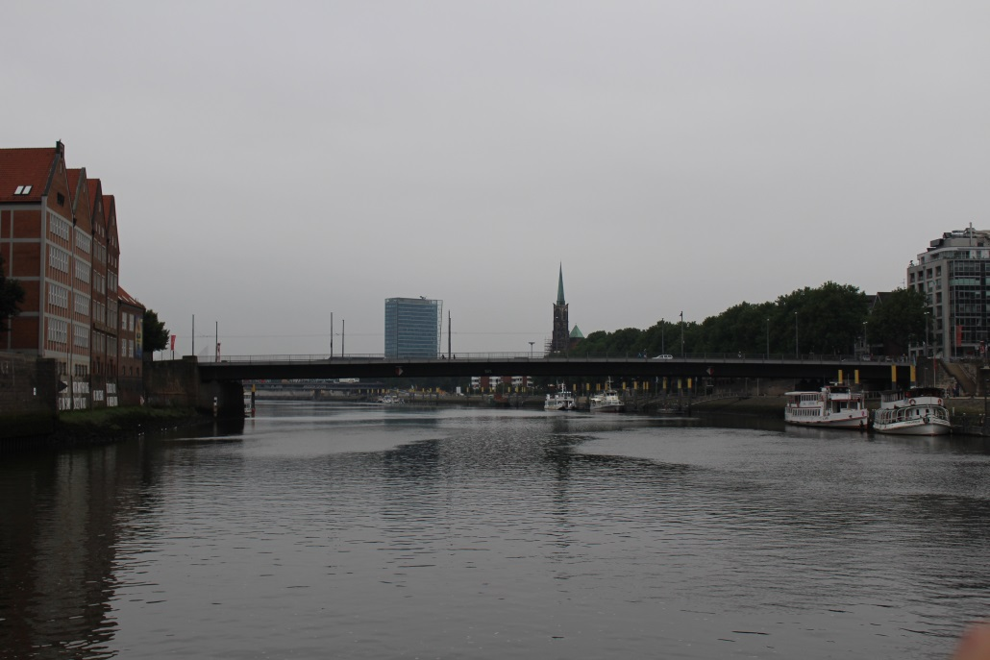
Tour on the Weser

Slide 10
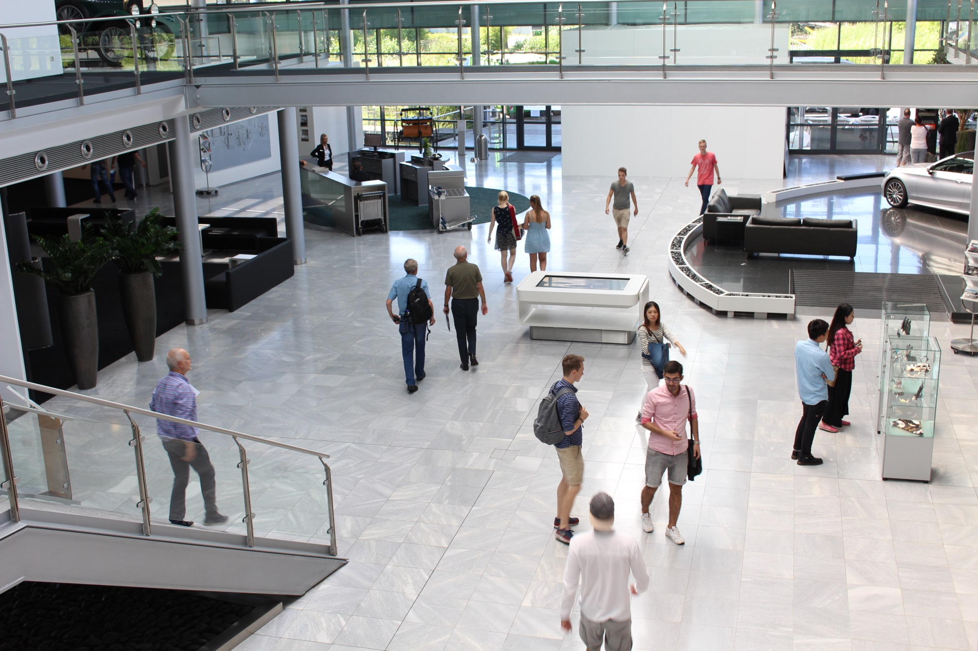
Visit to Mercedes Benz

Slide 11
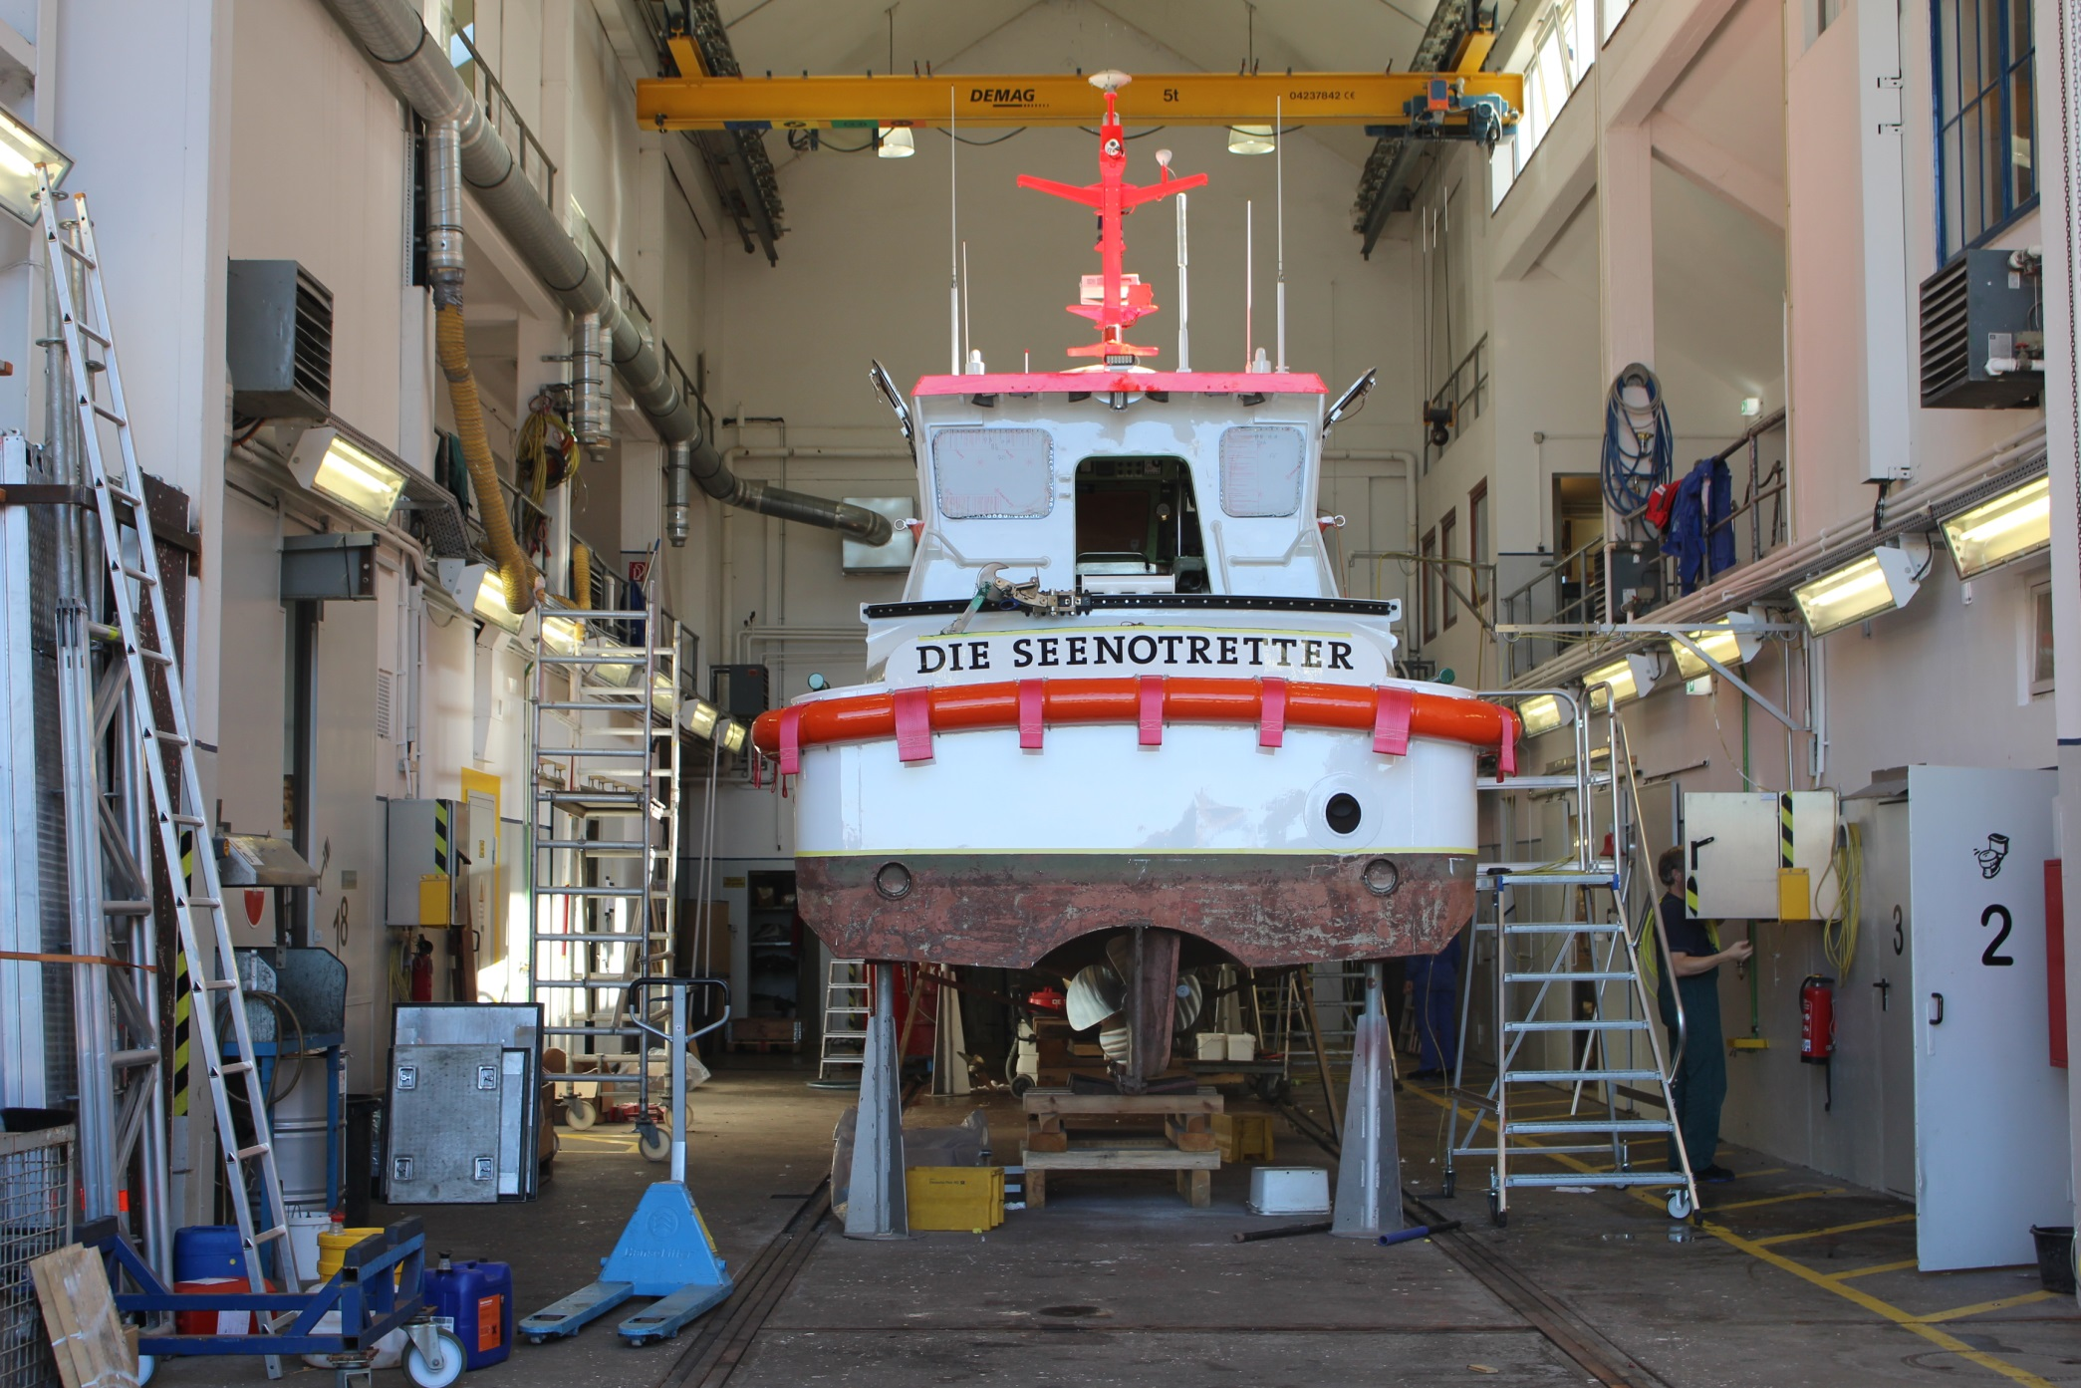
And the German coastguard

Slide 12
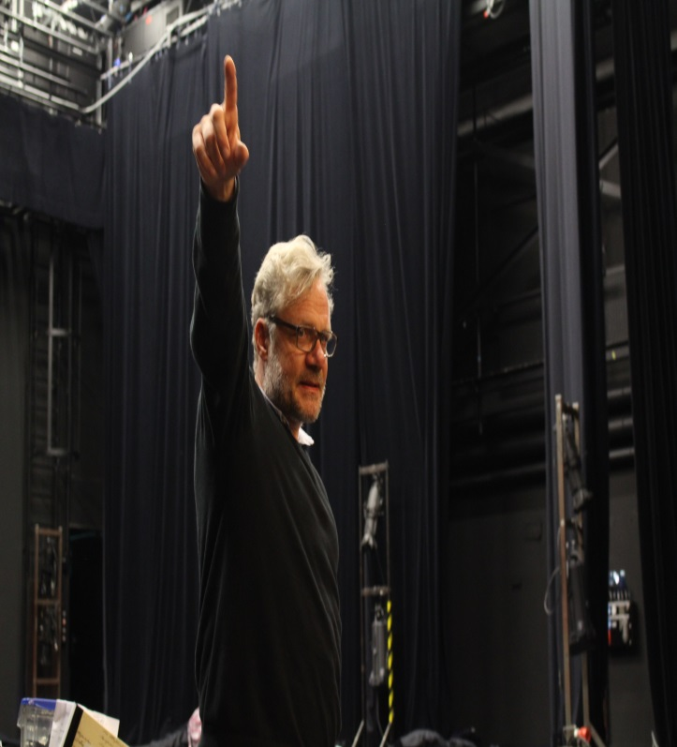
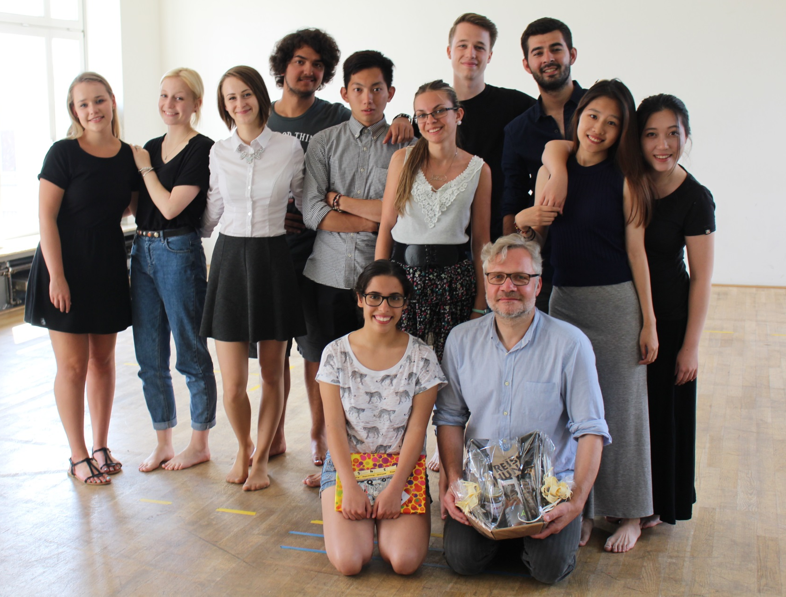
Bremen Theatre company workshop

Slide 13
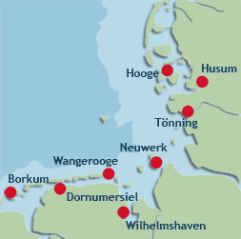
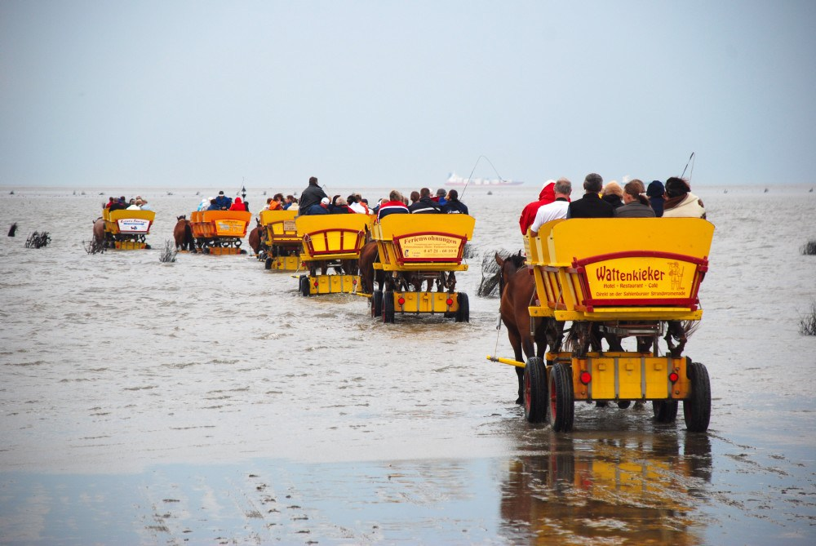
My favourite experience of the camp
Neuwerk is an island in the Nordsee. You can walk from the German shore to the island during low tide. About 13 km.
We walked to the island and spent the night in a “Heuhotel” (Hay Hotel) and returned the next day with horse drawn carriage.

Slide 14
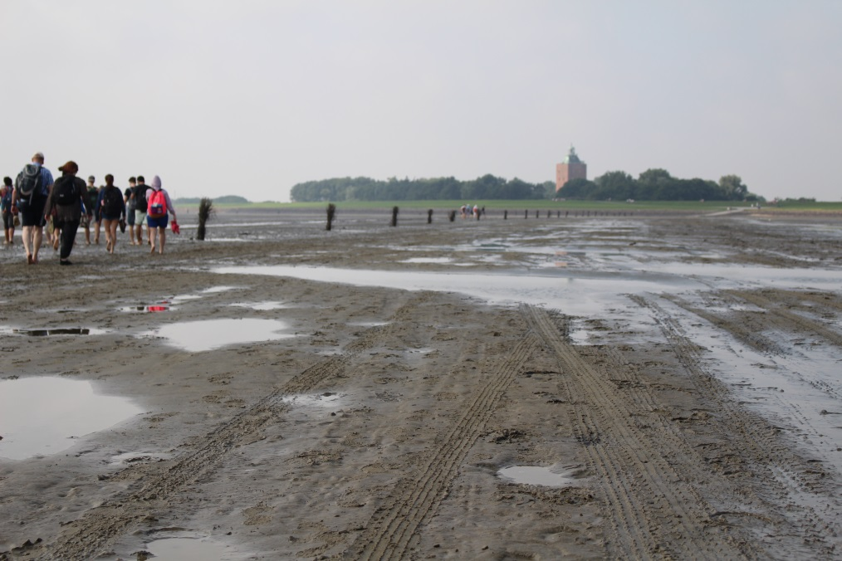
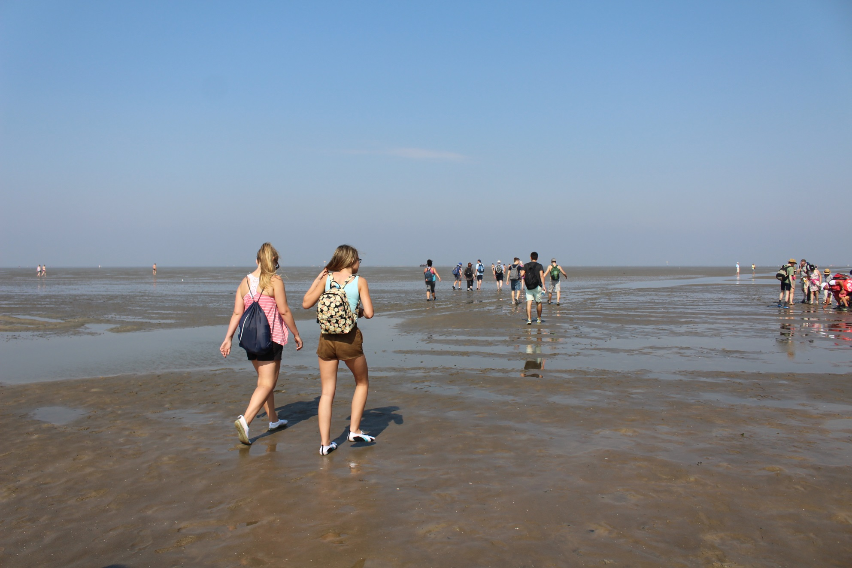
More mud walking…

Slide 15
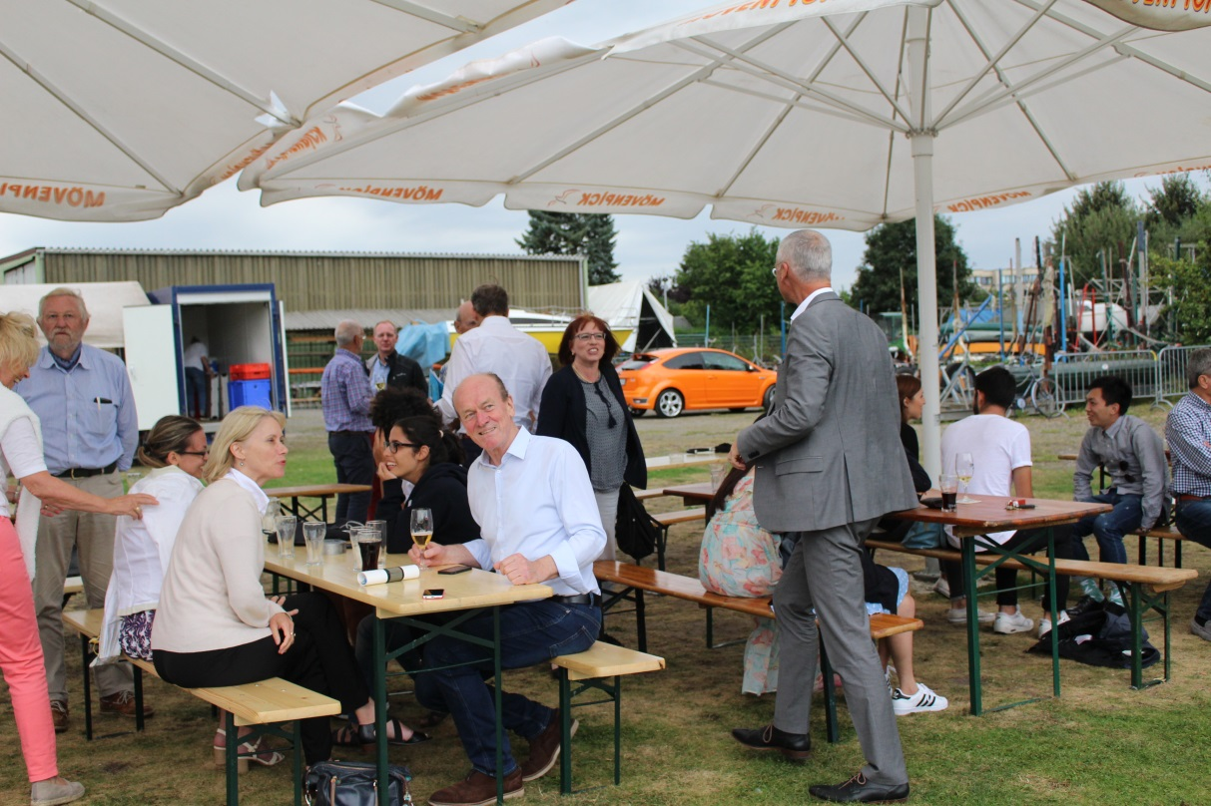
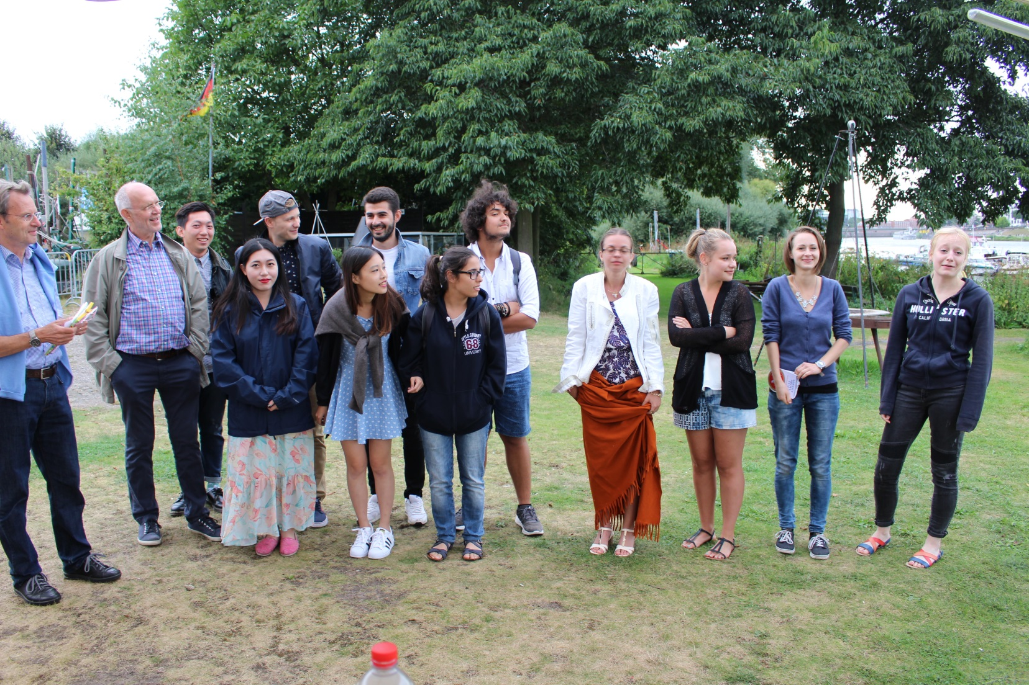
And the final farewell Party
Was ein tolles Erfahrung was ich mich immer errineren werde!
Vielen Dank!

