Slide 1
The victor daitz foundation/ jewish national fund of sa ecological education centre
hammarsdale

Slide 2
The victor daitz foundation/ jewish national fund of sa ecological education centre
The project is based in Hammarsdale, Durban
It is a joint project between:
  The Jewish National Fund of South Africa
  The Ethekwini Cleansing & Solid Waste Unit (known as DSW)
  The KZN Dept of Basic Education

Slide 3
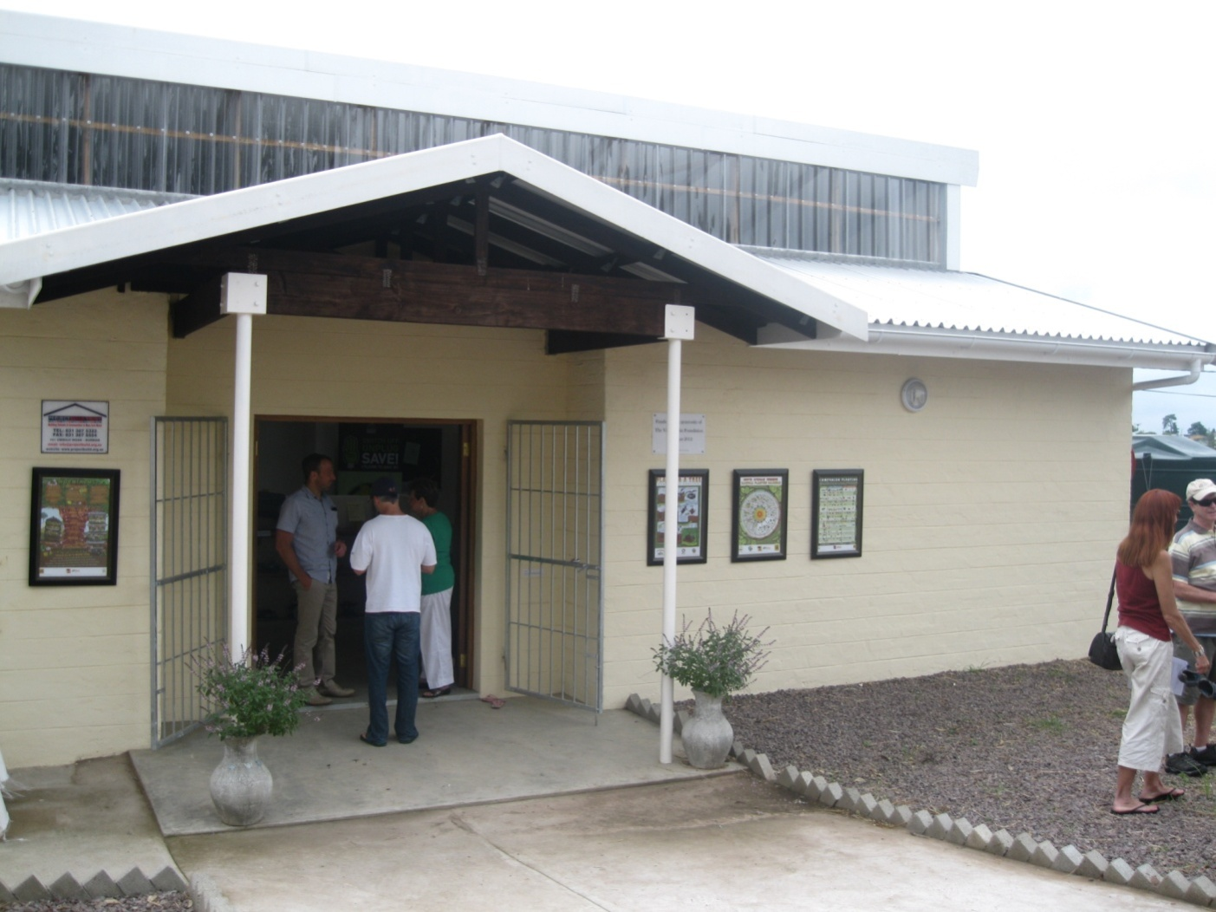
The classroom at hammarsdale

Slide 4
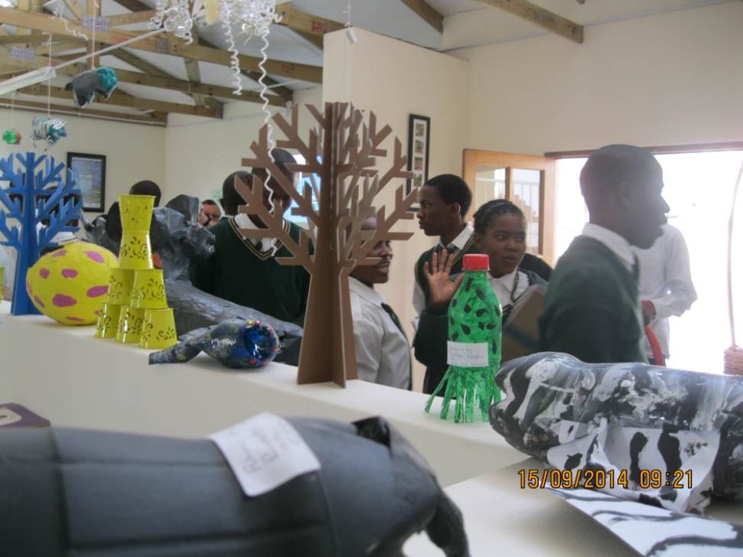
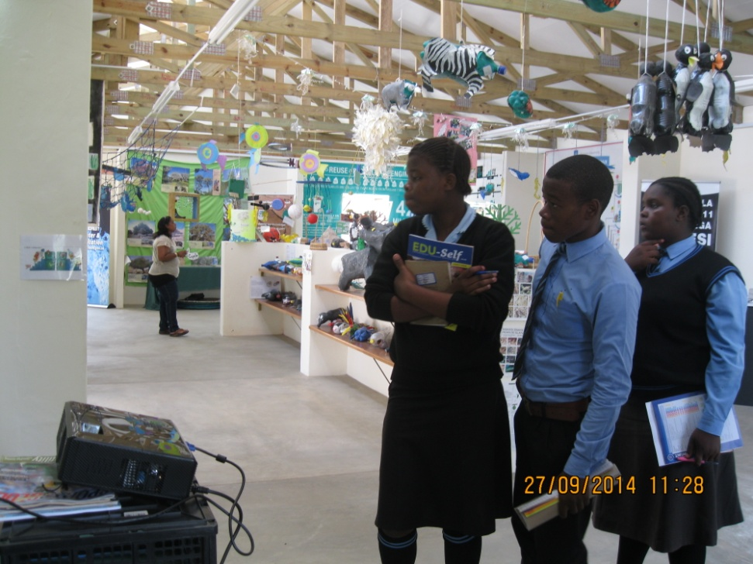
Inside the centre

Slide 5
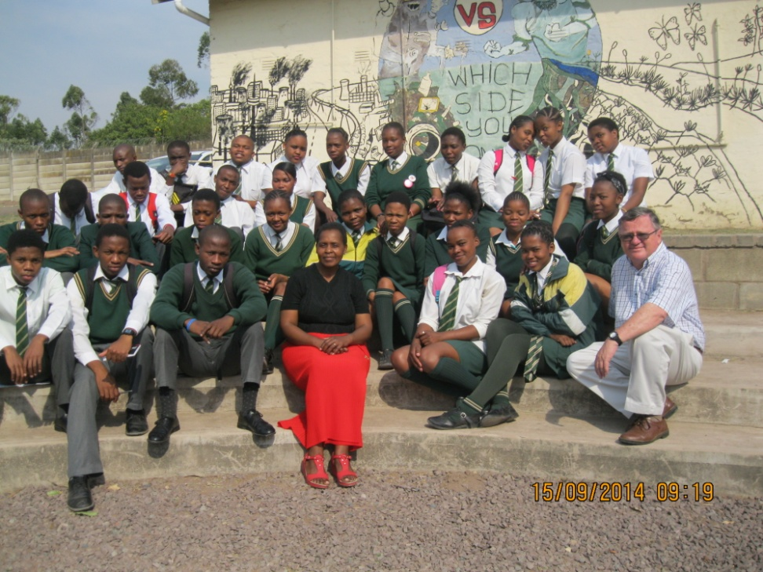
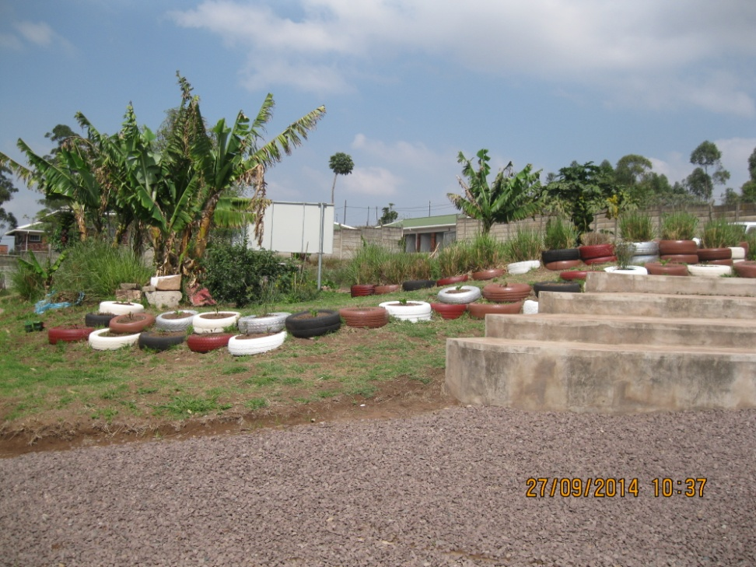
The Gardens
The Courtyard
The Permaculture Garden

Slide 6
Format of visits
Each visit is tailor made for the attending group
Maximum 60 learners in one session.
Rotational training is used.
Learners will be divided into groups of about 15 learners.
Each group will take part in sessions that are 20-25 minutes long and will rotate until all sessions are covered.

Slide 7
Topics covered
The Centre has developed a series of short modules on prescribed topics.
The topics are based on the school curriculum.
The programme offered to a school will be a ‘mix and match’ of the modules selected according to the needs of the learners.
The list of modules offered is being developed on an ongoing basis.

Slide 8
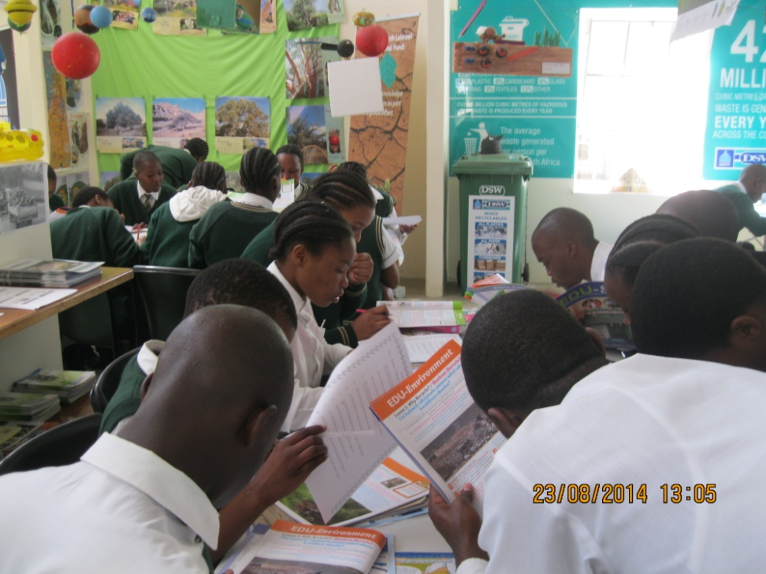
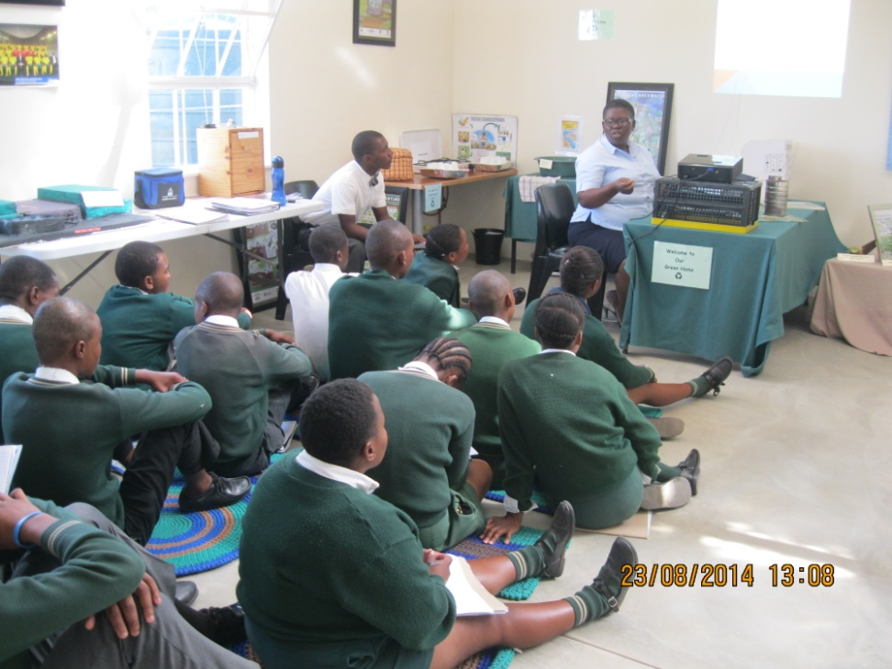
High school lessons
Research Exercise
Landfill Presentation – Grade 11

Slide 9
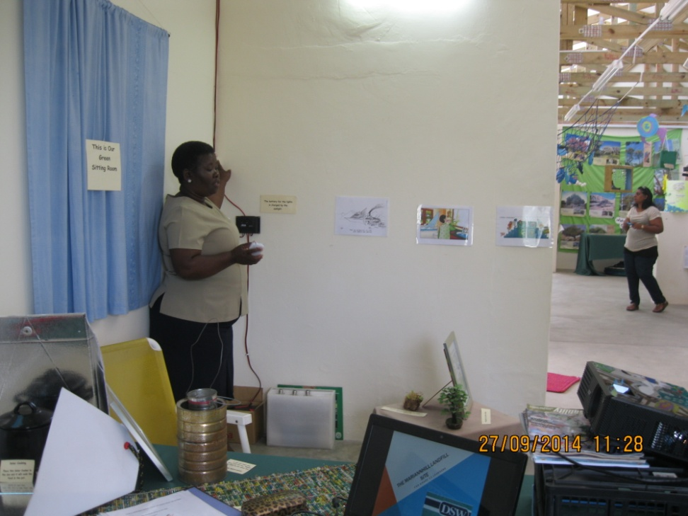
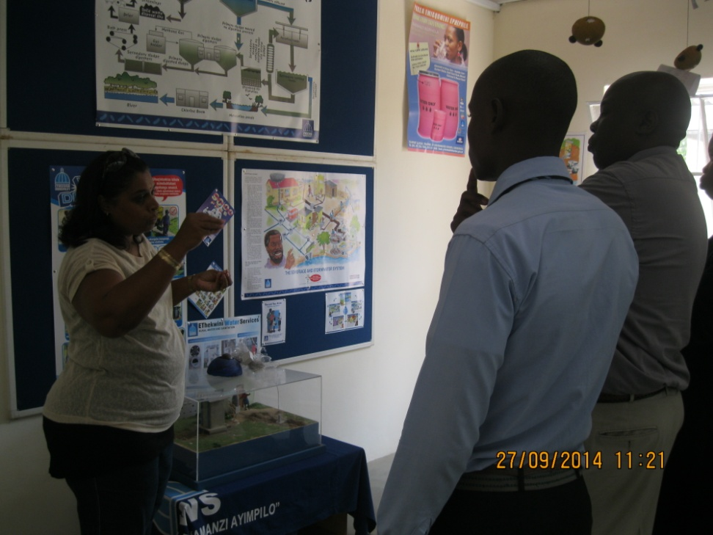
High school lessons
The Eco Friendly Home
Water Lesson

Slide 10
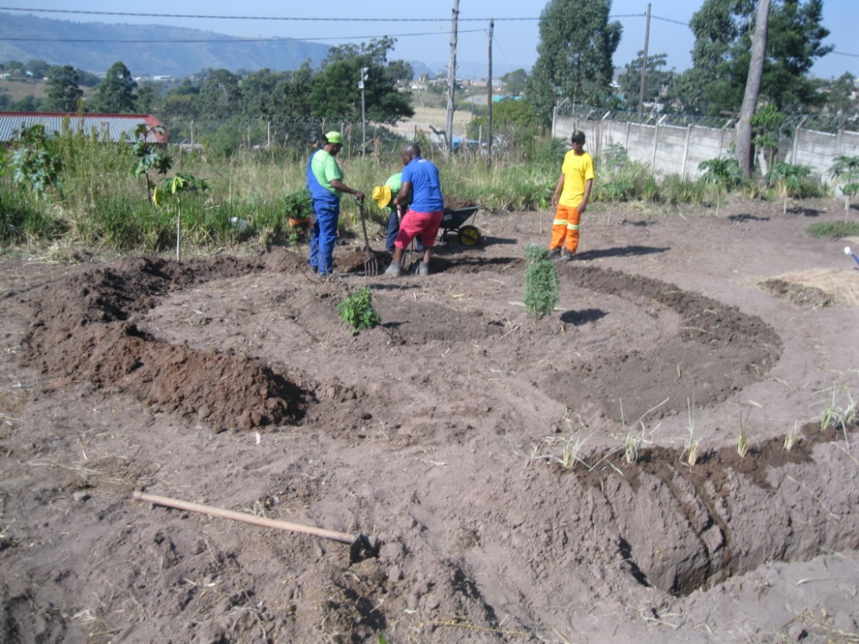
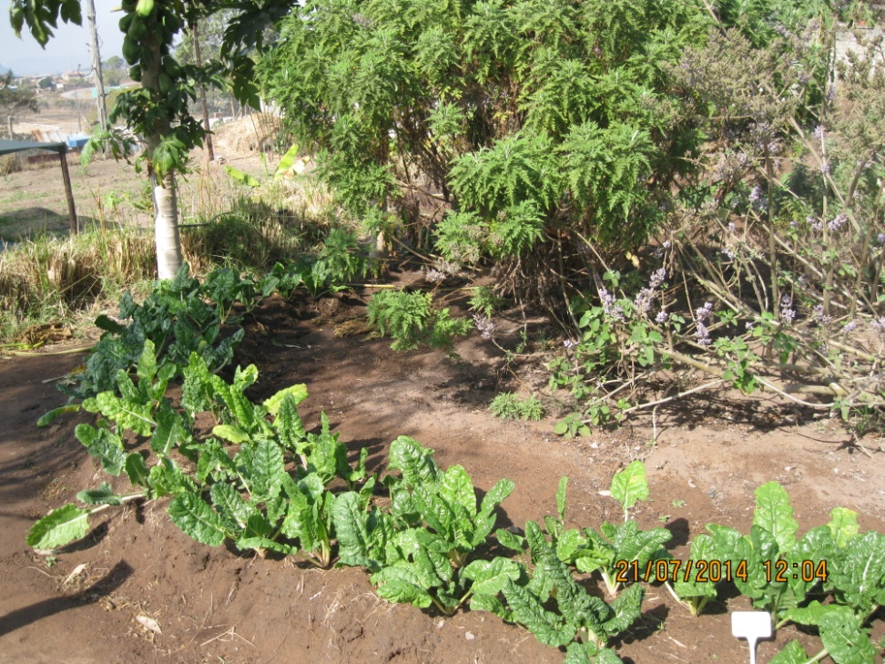
Permaculture garden
Getting Going
One Year Later

Slide 11
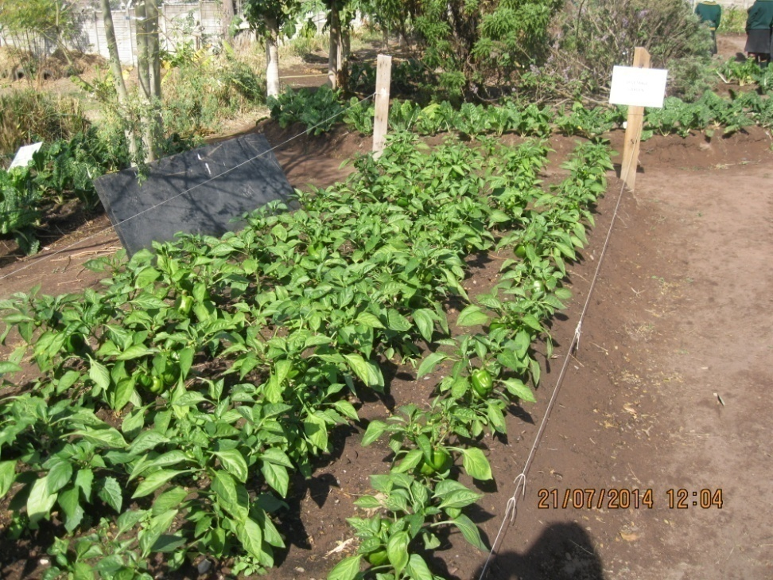
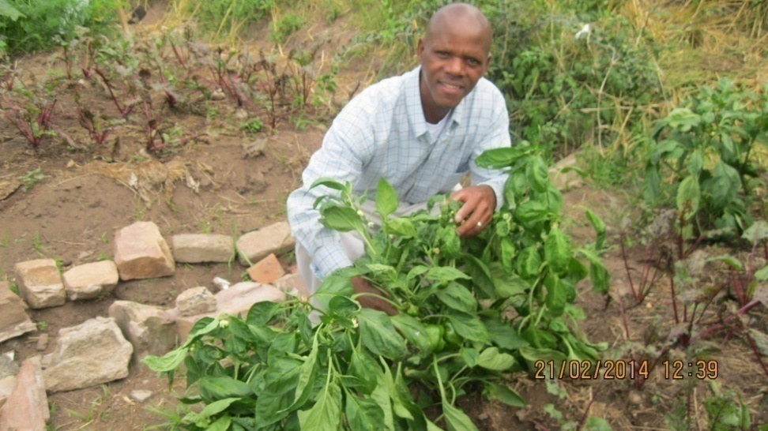
Permaculture garden today

Slide 12
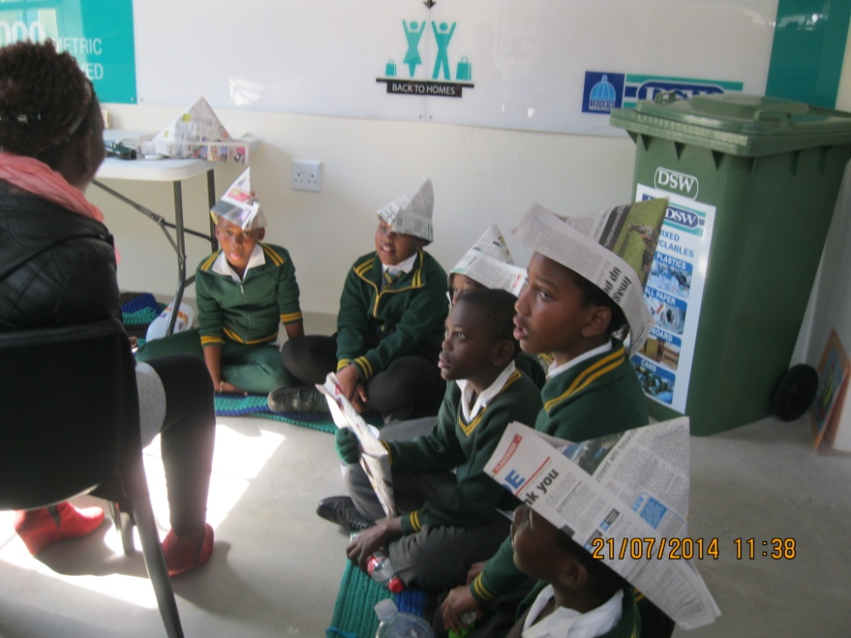
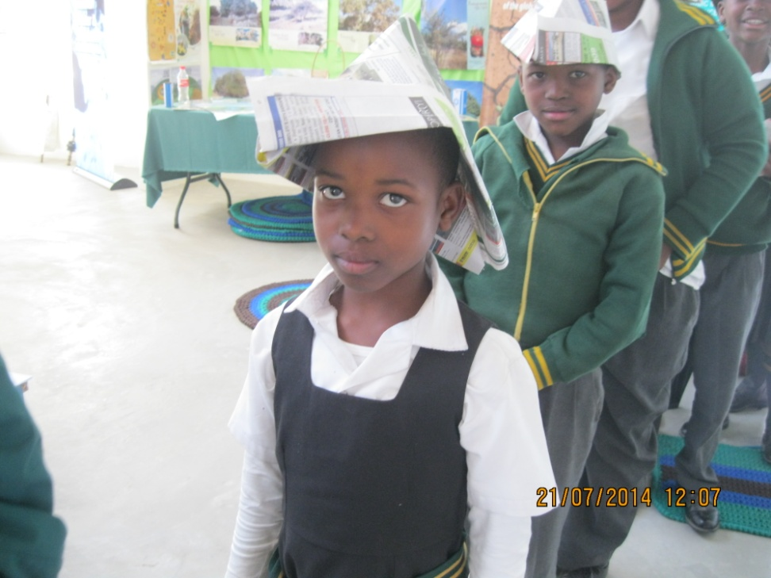
Primary School lessons
Lesson in recycling and crafts from waste
Introducing Recycling
Hat made from Newspaper

Slide 13
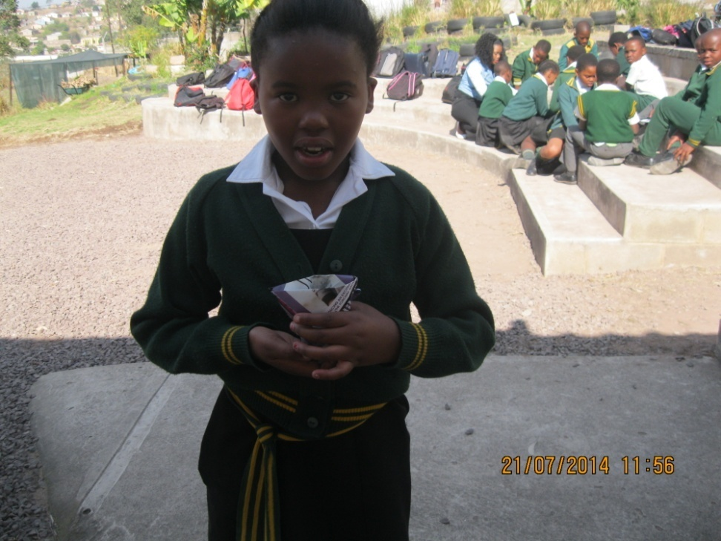
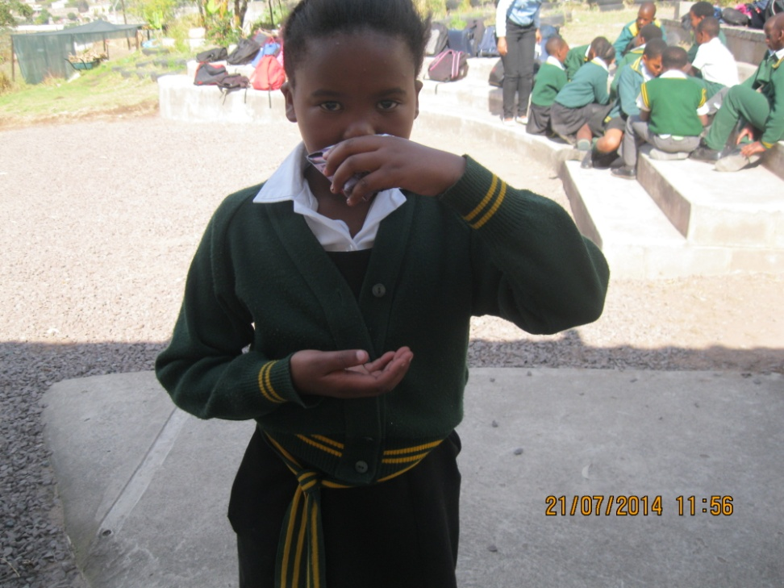
Primary School lessons
Lesson in recycling and crafts from waste
Cup made from folded paper
Having a drink from the cup

Slide 14
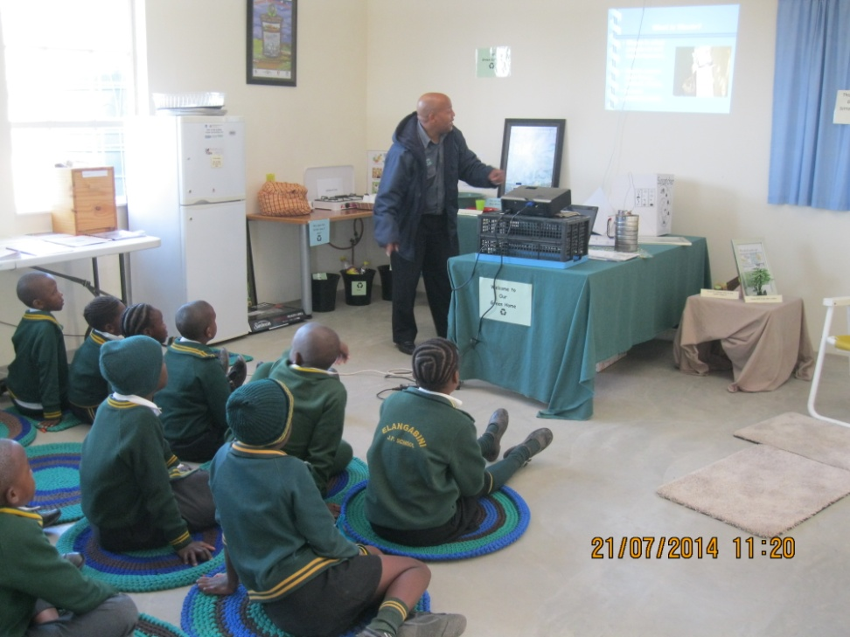
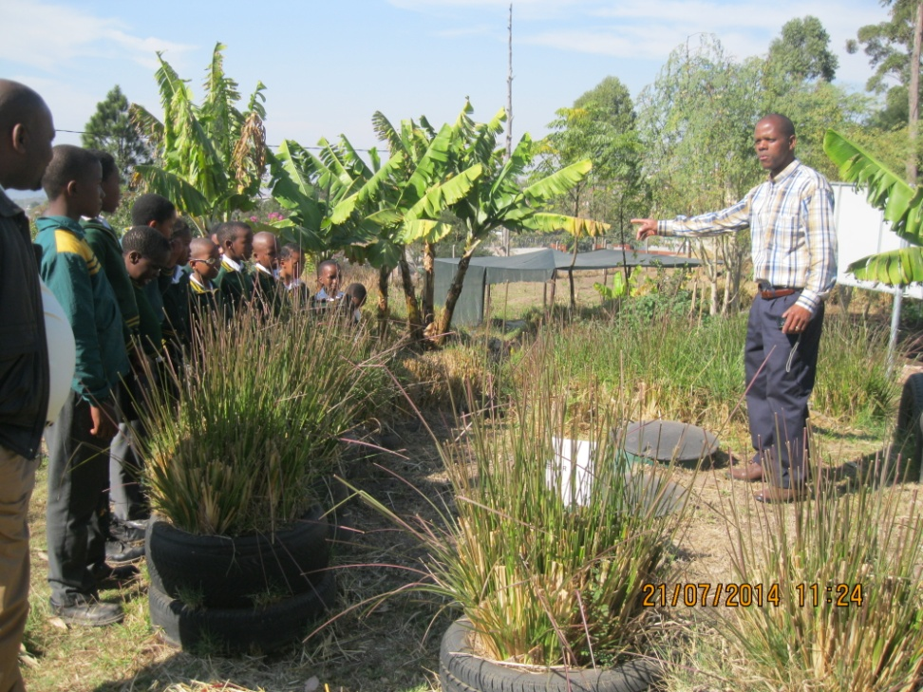
Primary school lessons
Presentation-
What is waste?
Permaculture Demo

Slide 15
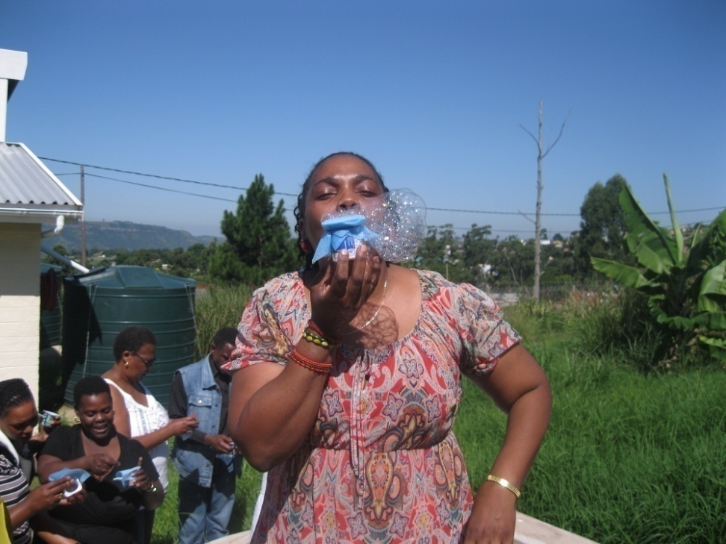
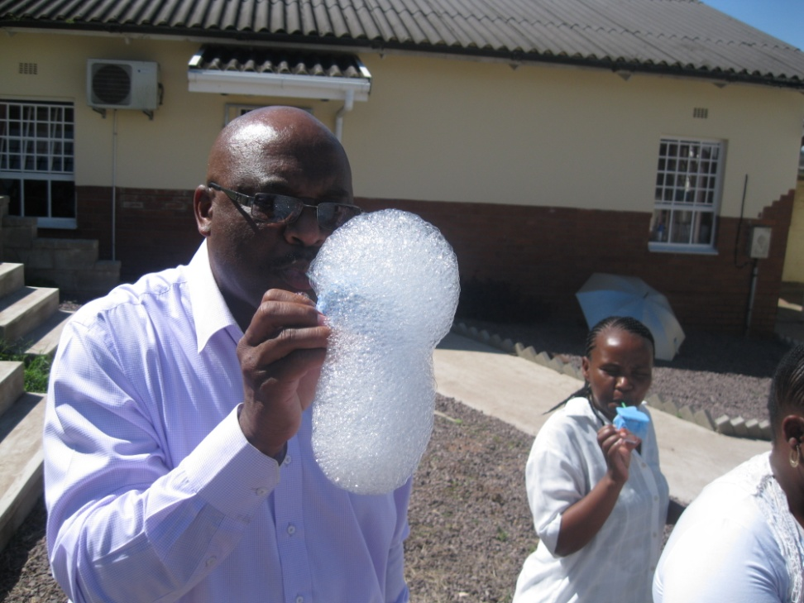
Teacher workshop in action

Slide 16
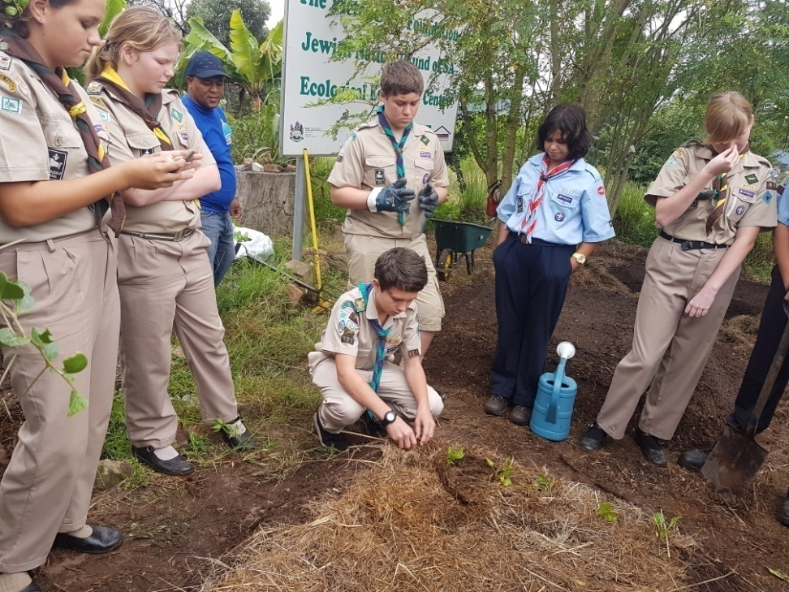
HOLIDAY ACTIVITIES
During school holidays the centre is available for youth groups.
To date scout groups and church Sunday Schools have visited the centre.
Programmes are tailored to meet the needs of the visitors eg The scout programme is designed to meet the requirements of the scout badge programme.

Slide 17
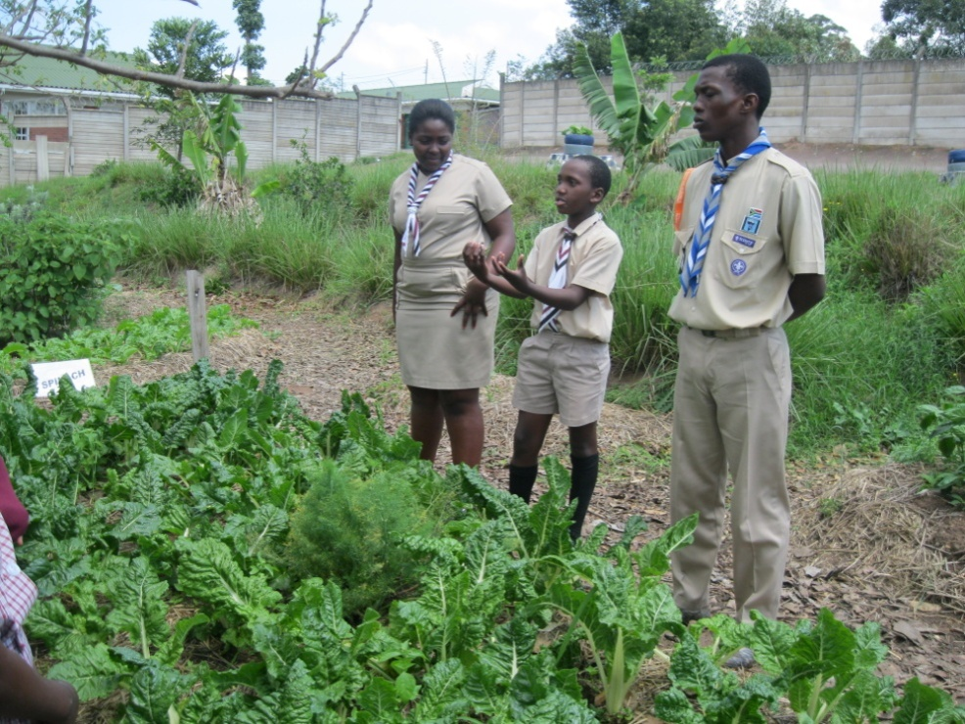
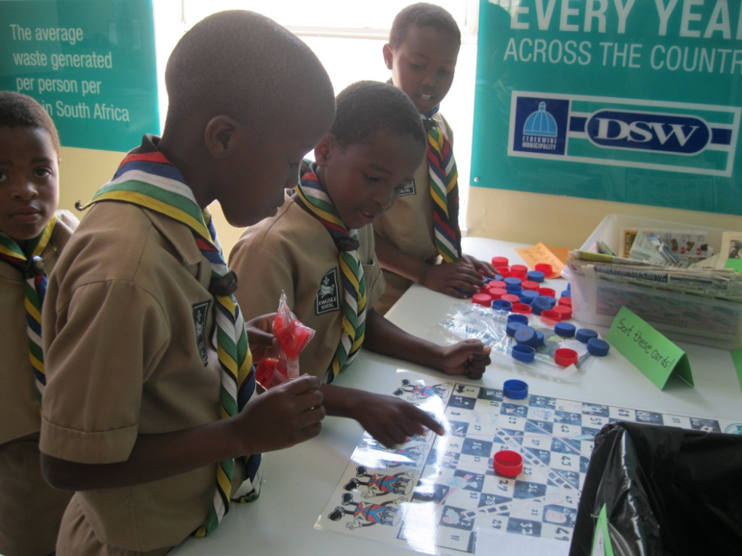
HOLIDAY ACTIVITIES (October 2015)

Slide 18
The centre has eco-friendly features
Solar Heating
Solar Lighting
Uses as much light natural light as possible
Demonstrates water harvesting from the roof
Demonstrates an environmentally friendly kitchen in terms of waste management and energy saving.
A biodigestor is now in use

Slide 19
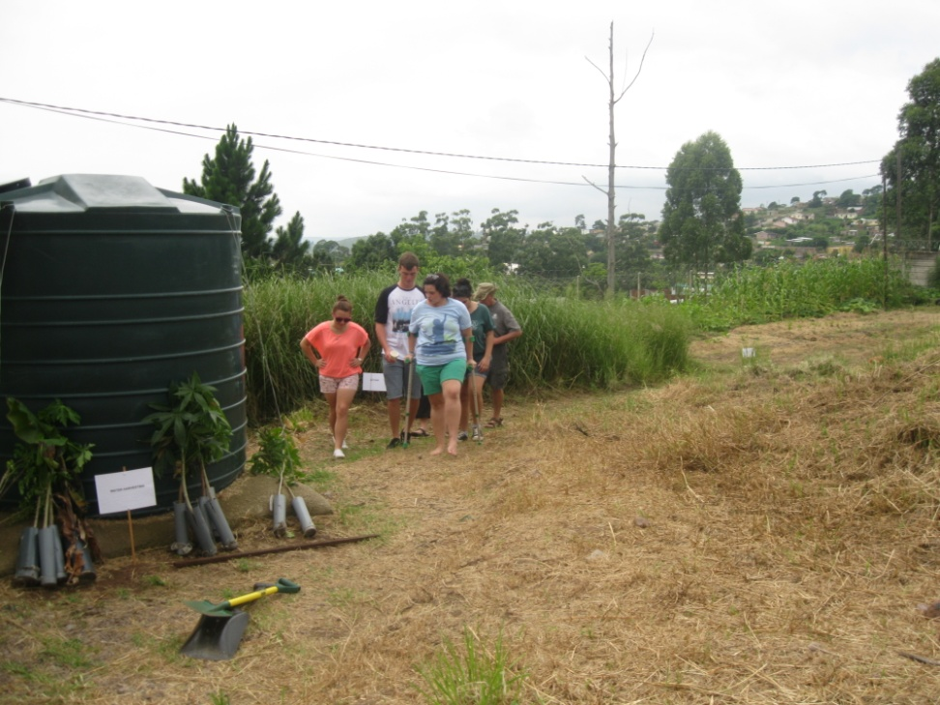
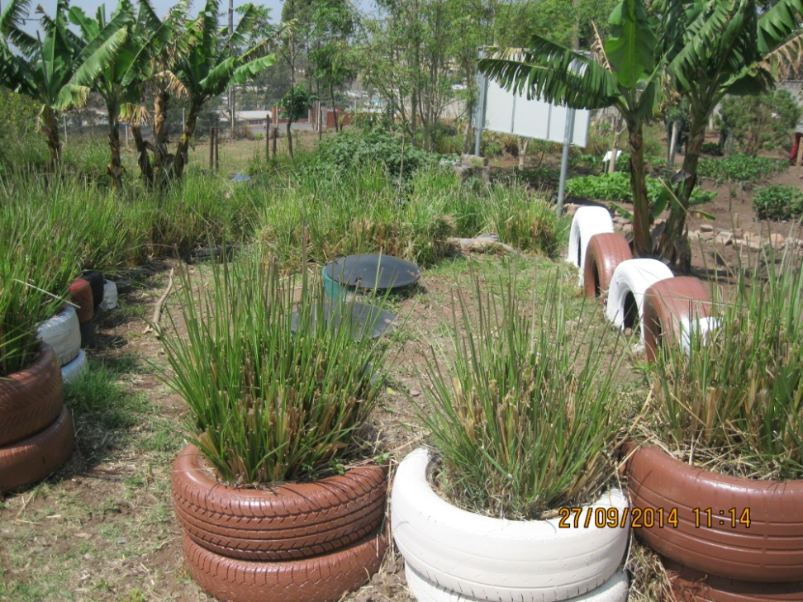
Eco friendly features
Water Harvesting
Biodigestor

Slide 20
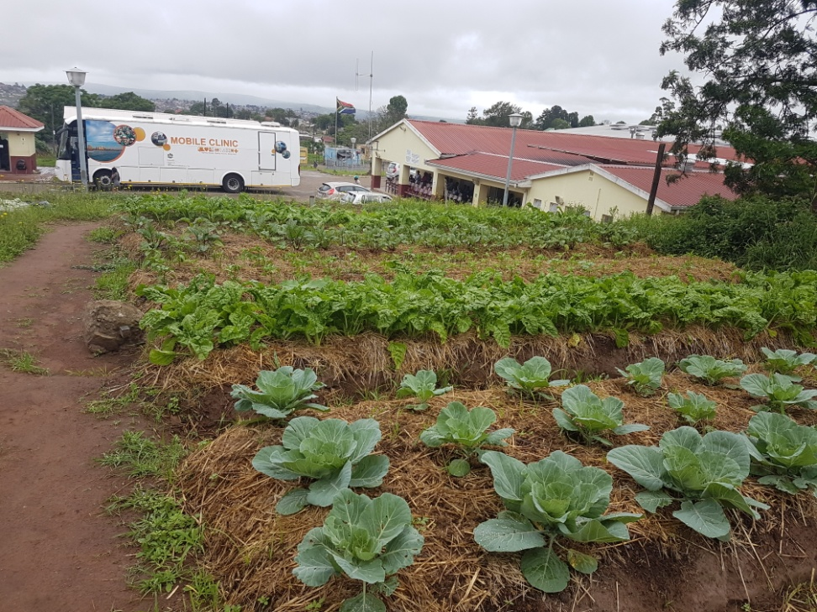
Adult programmes
Programmes are conducted for adult community groups.
The programmes include training in permaculture gardening, recycling and waste management.
To date 12 community gardens have been started by the community.
The picture shows the garden started by the Care Givers at the Mpumalanga Clinic after training at the centre.

Slide 21
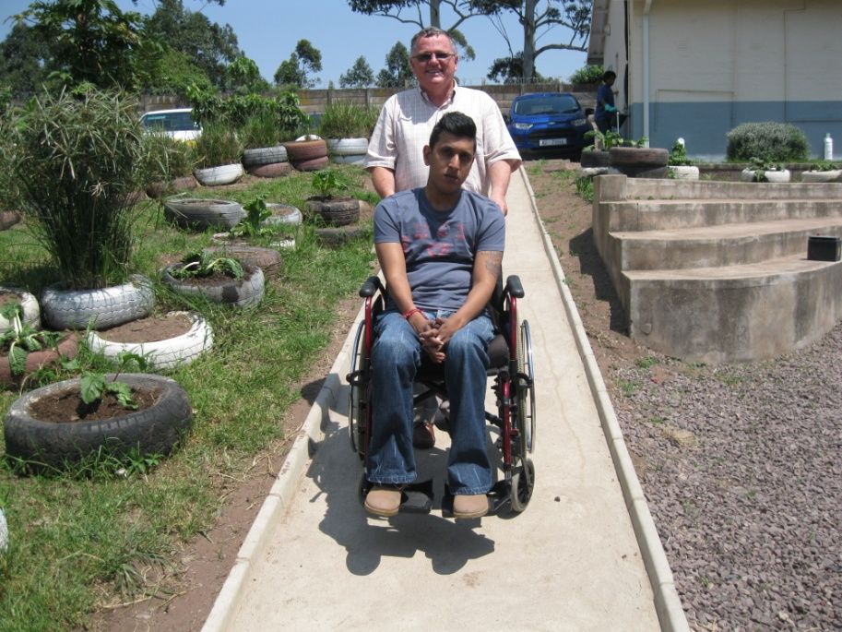
other projects
Permaculture gardening is being promoted with a
local co-op maintaining the garden.
Working with local NGOs promoting outreaches to community groups on environmental issues.
A bee hive has now been established at the centre.
The centre is now wheelchair friendly.

Slide 22
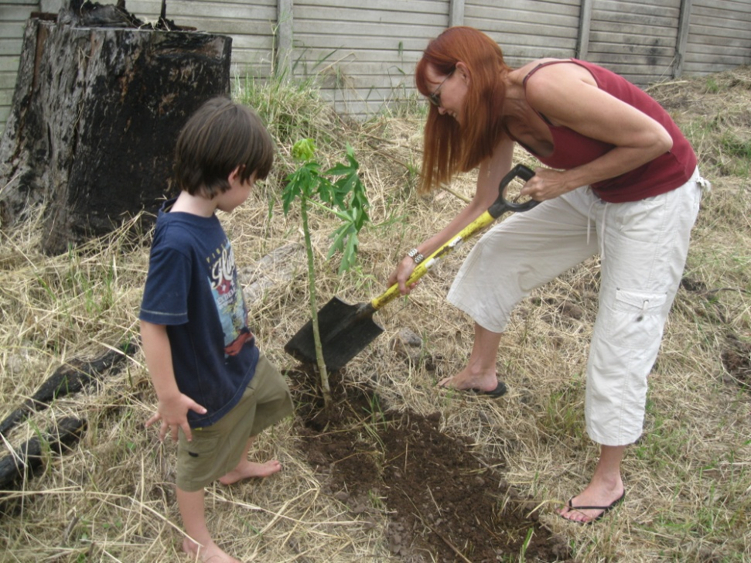
Tu’bshvat 13
Tu’bshvat is the Jewish celebration of the birthday of the trees.
Tu’bshvat has been celebrated three times at the centre.

Slide 23
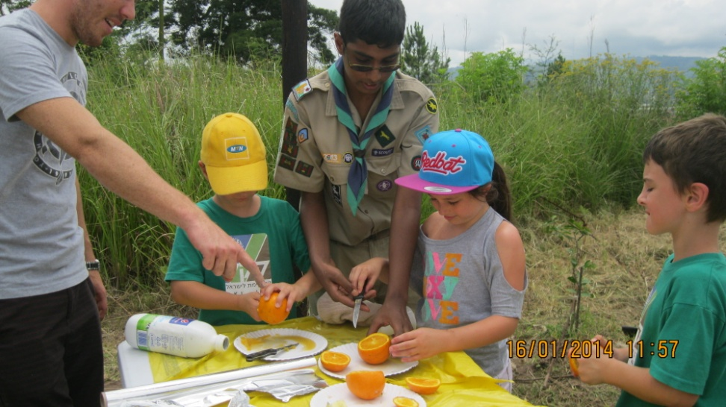
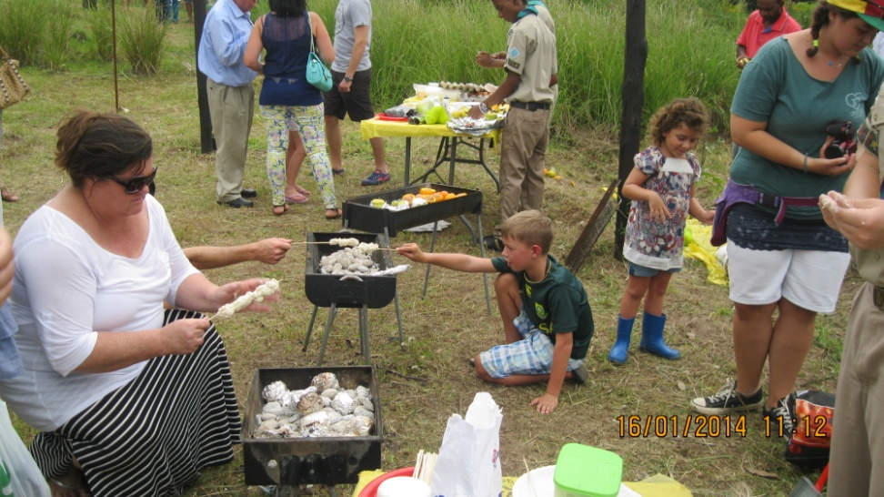
Tu’bshvat 14
A joint project with DSW and the scout movement

Slide 24
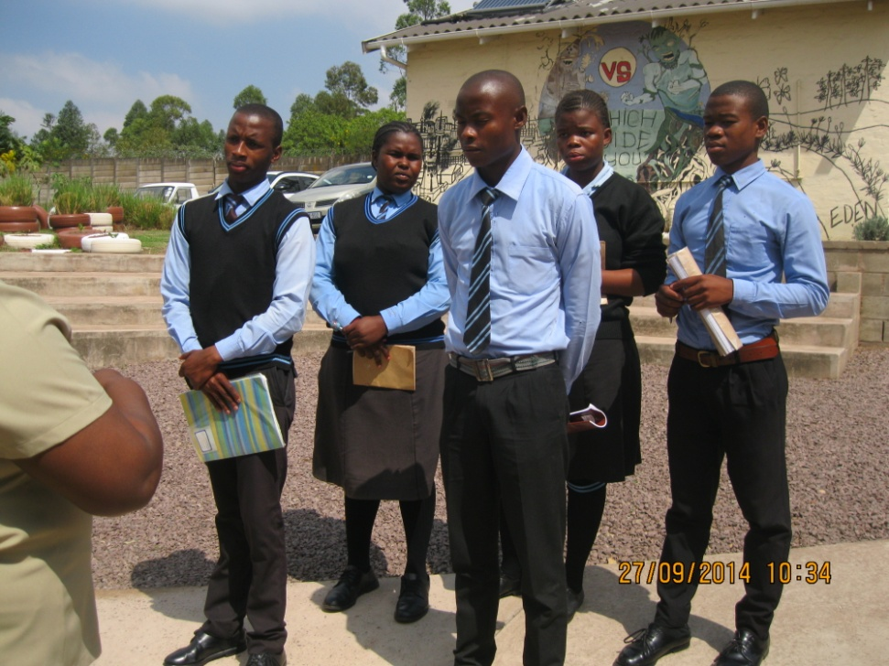
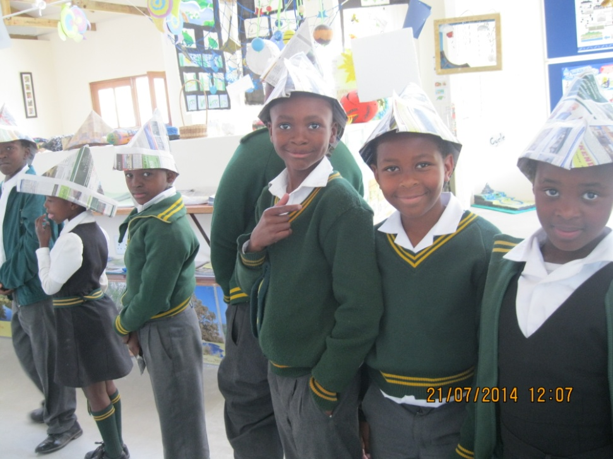
The end of the beginning

